Slide 1
Creating Accessible
Documents and Presentations

Slide 2
Overview
Contrast / Readability
Text Size & Formatting
Colour Contrast
Colour Blindness Considerations
Text Alternatives & Clear Labelling
Animations & Flashing
Language
Other Considerations
Resources

Slide 3
Text Size & Formatting
Don’t Do This!
There’s no exact guide to text size, as it very much depends on the display the presentation or document is being viewed on. Consider this when editing, and choose the largest reasonable size, and stay consistent between slides or pages. Choose a simple font with good letter spacing and set a larger line spacing to make reading easier. Try to avoid large single blocks of text, and avoid lines of text that span the width in landscape, between 50 and 75 characters per line is optimal for easy reading.
Proin varius felis suscipit ligula placerat pretium. Morbi nec ullamcorper lacus, nec cursus nisi. Donec vehicula, eros sed commodo efficitur, turpis massa aliquam urna, in feugiat est felis eu tortor. Aenean nisi libero, congue in interdum at, consequat ac odio. Nulla facilisi. Praesent tempus placerat.
Proin varius felis suscipit ligula placerat pretium. Morbi nec ullamcorper lacus, nec cursus nisi. Donec vehicula, eros sed commodo efficitur, turpis massa aliquam urna, in feugiat est felis eu tortor.
Proin varius felis suscipit ligula placerat pretium. Morbi nec ullamcorper lacus, nec cursus nisi. Donec vehicula, eros sed commodo efficitur, turpis massa aliquam urna, in feugiat est felis eu tortor.
Notes:
In the first example the font size is too small and too close In the second example the font is well spaced, but too small and complex In the third example text is large enough and clear enough, but too close

Slide 4
Colour Contrast
Don’t Do This!
Important information should have a contrast ratio of at least 4.5:1 or ideally 7:1 compared to the background. Some editing tools have a built-in way to help you check this, and there are many online tools. Somewhat confusingly very high contrast should also be avoided, try to avoid pure black against pure white. Avoid distracting or gradient backgrounds if possible, solid colours are much easier to read against. Some colours (like orange or other vibrant shades) are generally best avoided altogether as they’re hard to achieve reasonable contrast with against any colour.
White Text On Black Background
21:1
4:1
Dark Text On Dark Background
4:1
Light Text On Light Background
3:1
Light Text On Vibrant Background
Light Text On Orange Background
3:1
~4:1
Text On Gradient Background
Notes:
High contrast can be a problem because it produces glare that makes it harder to read and can cause eye strain

Slide 5
Colour Blindness Considerations
Colour Blindness Comparison
Some special consideration should be given to using colours which cannot be easily distinguished by people with colour blindness. Avoid using colour on it’s own to convey meaning, for example red for bad and green for good in graphs and charts. Colour blind safe palettes are available in some graphing software, but providing labels as well helps make things even clearer. Around 4.5% of the population have some form of colour blindness.
“Normal” Vision
Protanopia (low red)
Deuteranopia (low green)
Tritanopia (low blue)

Slide 6
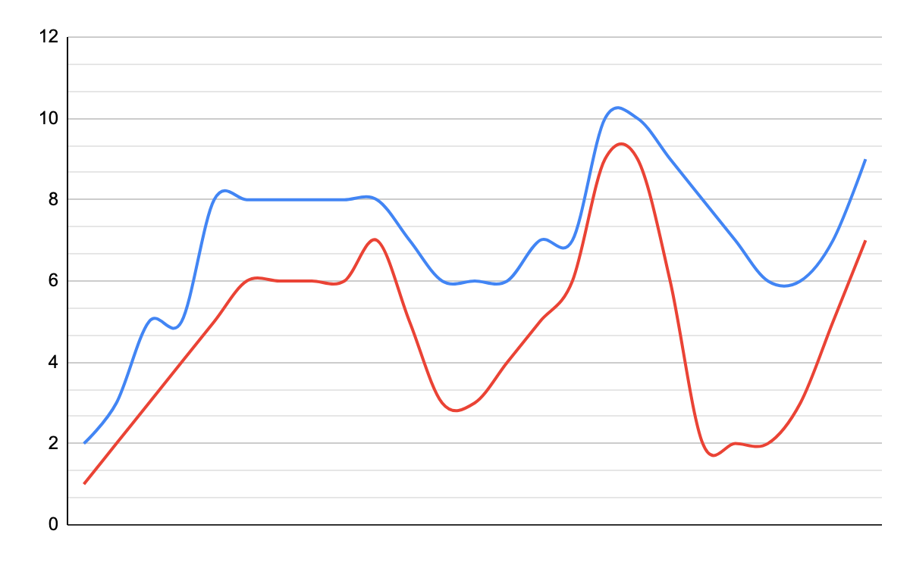
Text Alternatives & Clear Labelling
Don’t Do This!
Any important images or graphs should ideally have accompanying descriptive text and clear labels where appropriate to make them easier to understand. Adding decent accompanying text also has the benefit of making it easier understand or in the case of slides easier to look back through later without the speaker. Full speaker notes against the slides on presentations also helps in this regard. Although much less common, if your presentation or document also includes audio or video elements, accompanying subtitles should be provided.
Notes:
The graph would ideally have an accompanying annotation that describes what it shows, what the peaks and troughs are, etc. Anything that the speaker will mention while talking about the slide.

Slide 7
Animations & Flashing
If possible avoid using any animations, especially those within presentation slides that may be distracting from the main content. Slide transitions should ideally be immediate rather than animated. If animations and videos are key to the presentation or document be especially cautious of any part that flashes, and remove if possible as it could trigger epilepsy. The worst flash rates are those between 16 and 25 times a second. 25 - 30 frames a second is common for video, so any video with high motion or regular alternating patterns like bars or stripes could be a high risk. If an animation or video could be a risk, provide a warning before the animation or video starts, allowing adequate time for people to respond, and let people know when they can look back.

Slide 8
Language
Don’t Do This!
Visuals aren’t the only important thing when considering accessibility. The language you use can also make a document or presentation less accessible. Avoid using jargon, slang or abbreviations unless you’re very confident your audience will understand. Keep language simpler where possible as well, avoiding long or complex words. If possible, when using an abbreviation because doing otherwise would make for excessively long sentences explain what it stands for the first time you use it, even if you think it is generally well understood.
In the fall of 2019 the IAB deprecated TCF v1.1 and introduced TCF v2.0, it’s new GDPR framework, after extensive consultation with the ICO and EDPB.
We introduced a novel method of analysing data that resulted in incremented performance, beyond what we previously conceived possible.
The project had a lot of moving parts, and was a big of a long shot, but we still didn't want to cut corners.
Notes:
The first example uses lots of abbreviations and technical terms, as well as an americanism (fall) that might not make sense to some people
The second examples uses overly complex language, where simpler language could be used
The third example uses a lot of idioms that while not complex as such could add unnecessary confusion

Slide 9
Other Considerations
Some other considerations to aid in accessibility include:
For presentations provide the full slides with speaker notes afterwards so people can read back through them for anything they may have missed.
Even better, provide the document or presentation slides in advance if possible so people can read along under ideal conditions or use their preferred accessibility tooling.

Slide 10
Resources
Online Contrast Checkers https://webaim.org/resources/contrastchecker/ https://contrast-ratio.com/
Stark: Accessibility tooling for design products https://www.getstark.co/
How to use the Accessibility Checker in Powerpoint https://support.microsoft.com/en-us/office/improve-accessibility-with-the-accessibility-checker-a16f6de0-2f39-4a2b-8bd8-5ad801426c7f
Apple Keynote Accessibility guidelines https://support.apple.com/en-gb/HT210563

